Slide 1
Mintel Breakfast Insights

Slide 2
Key Points
47% of consumers believe breakfast is the most important meal of the day → -8pts vs. 2014
42% of consumers find eating a healthy breakfast makes them feel better about themselves
81% of consumers eat breakfast at home
40% of consumers eat breakfast foods at other mealtimes
36% of consumers are eating more breakfast foods from a store
44% of consumers typically eat the same breakfast every day
88% of consumers eat cereal for breakfast
19% of consumers eat cereal for a snack
62% of all consumers report making more breakfast from scratch in the morning as a result of COVID-19
Source: Mintel Breakfast Foods: Incl Impact of COVID-19 October 2020
KIND Management Inc. – Confidential

Slide 3
About half of consumers believe breakfast is the most important meal of the day
Importance of Meals
Source: Mintel Breakfast Foods: Incl Impact of COVID-19 October 2020
Q: What is the most important meal of the day? Please select all that apply.
KIND Management Inc. – Confidential

Slide 4

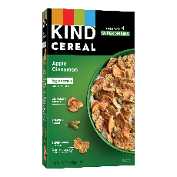
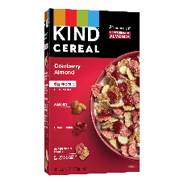
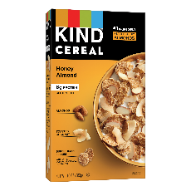
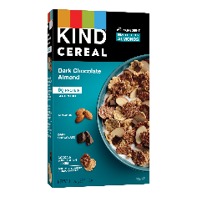

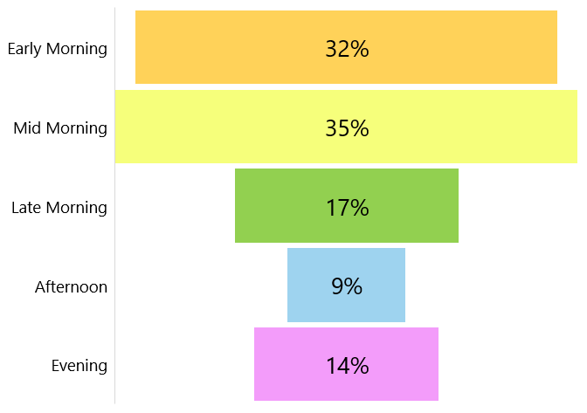
Consumers eat cereal all throughout the day, but primarily in mid morning
2.6
Cereal Consumption Occasions
84%
Total in the Morning!
Source: Mintel Breakfast Foods: Incl Impact of COVID-19 October 2020
Q: During which of the following occasions do you or other members of your household typically eat cereal? Please select all that apply.
KIND Management Inc. – Confidential

Slide 5



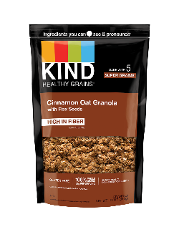
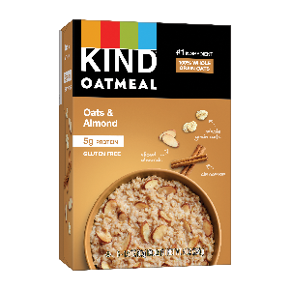
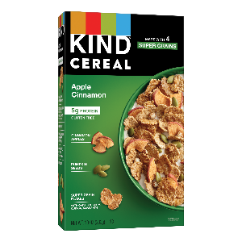
KIND Breakfast offers a healthy option for one of the most important meals of the day
Consumers are looking for healthy breakfast options
of consumers state breakfast is the most important meal of the day
of consumers find eating a healthy breakfast makes them feel better about themselves
47%
42%
KIND Breakfast is Giving Consumers What They Want…
#1 ingredient nutrient dense
No artificial sweeteners or added sugars
Better-for-you ingredients
Source: Mintel Breakfast Foods: Incl Impact of COVID-19 October 2020
KIND Management Inc. – Confidential

Slide 6
Due to COVID-19, consumers are focusing on their health especially in the breakfast category
Consumers’ Shift Toward Health
Important Breakfast Components to Consumers
67%
of US consumers put deep thought into what food they put into their bodies
A healthy breakfast is the #1 attribute!
42%
of consumers agree that they feel better about themselves when they eat a healthy breakfast
Source: Mintel Hot and Cold Cereals: Including the Impact of COVID-19 September 2020
Q: Which of the following are important to you when selecting a breakfast food? Please select all that apply.
KIND Management Inc. – Confidential

Slide 7

Consumers are looking for healthy and quick to prepare breakfast foods but wont sacrifice flavor
Important Attributes When Selecting Breakfast
June 2020
Top 3
Attributes
Source: : Mintel Breakfast Foods: Incl Impact of COVID-19 October 2020
Q: Which of the following claims are important to you when selecting a breakfast item? Please select all that apply.
KIND Management Inc. – Confidential

Slide 8


Of healthy breakfast options, Protein is the attribute consumers look for in a healthy breakfast option
Consumers Outlook on a Healthy Breakfast
Consumers want protein
And want a healthy outcome
71%
of consumers are willing to try a new cereal if there is added protein
64%
of consumers believe high protein constitutes a healthy breakfast
Source: Mintel Hot and Cold Cereals: Including the Impact of COVID-19 September 2020
Q: Which of the following do you think constitutes a healthy breakfast? Please select all that apply.
KIND Management Inc. – Confidential

Slide 9
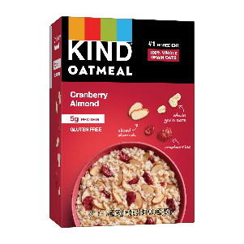
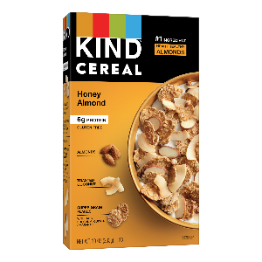
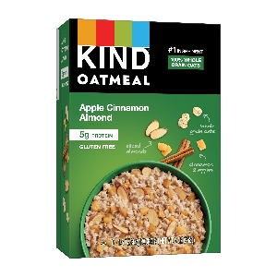
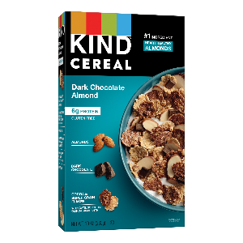
Cereal is the #1 most consumed breakfast food, KIND Cereal being a great option for consumers
Breakfast Consumption
#1
Consumed
Introducing KIND Hot and Cold Cereal…
#1 ingredient nutrient dense
No artificial sweeteners or added sugars
Better-for-you ingredients
Source: Mintel Breakfast Foods: Incl Impact of COVID-19 October 2020
Q: During which of the following occasions do you or other members of your household typically eat the following foods? Please select all that apply per food type.
* Cereal = Hot and Cold Cereal
KIND Management Inc. – Confidential

Slide 10
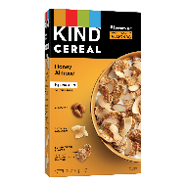
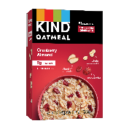


KIND’s Promise aligns with the top 3 attributes consumers are looking for in breakfast
Important Attributes When Selecting Breakfast
54%
54%
51%
Healthy
Quick to Prepare
Flavorful
KIND’s Promise is Giving Consumers What They Want…
Guardrail #1
Convenient
Guardrail #2
Healthy & Tasty
Guardrail #3
Real
Makes eating healthy easier
Created for convenience
Nutrient rich ingredients
Minimal sugar
Uncompromisingly Delicious
Ingredients you can see and pronounce®
No artificial sweeteners, preservatives, colors or flavors
Source: Mintel Breakfast Foods: Incl Impact of COVID-19 October 2020
Q: Which of the following claims are important to you when selecting a breakfast item? Please select all that apply.
4
KIND Management Inc. – Confidential

Slide 11
BFY Cereal gives the consumer a solution to their needs of convenience and health during the pandemic
Consumers Outlook on a Healthy Breakfast
BFY Cereal Offer Consumers a Healthy Breakfast Solution
Swap out “BFY Cereal” as needed
76%
of consumers want convenient products
54%
of consumers look for healthy breakfast options
BFY Cereal
Source: Mintel Hot and Cold Cereals: Including the Impact of COVID-19 September 2020
Q: Which of the following do you think constitutes a healthy breakfast? Please select all that apply.
KIND Management Inc. – Confidential

Slide 12


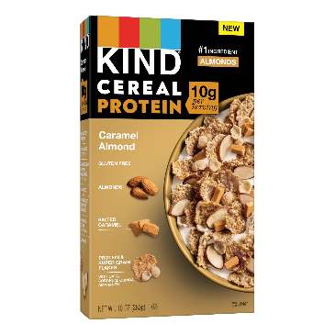
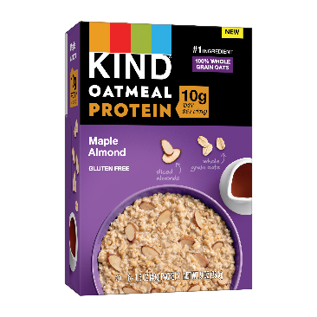




Protein is a big contender in the hot and cold cereal categories – being a promising opportunity for KIND
Consumers want protein
And want a healthy outcome
71%
of consumers are willing to try a new cereal if there is added protein
64%
of consumers believe high protein constitutes a healthy breakfast
KIND Capitalizing on These Trends
10g of Protein per Serving
#1 Ingredient Almonds
Real Ingredients
10g of Protein per Serving
100% Whole Grain Oats
Real Ingredients
Source: Mintel Hot and Cold Cereals: Including the Impact of COVID-19 September 2020
KIND Management Inc. – Confidential

Slide 13
Consumers eat cereal all throughout the day, but primarily in mid morning
2.6
Cereal Consumption Occasions
84%
Total in the Morning!
Source: Mintel Breakfast Foods: Incl Impact of COVID-19 October 2020
Q: During which of the following occasions do you or other members of your household typically eat cereal? Please select all that apply.
KIND Management Inc. – Confidential

Slide 14
Appendix

Slide 15



About half of consumers believe breakfast is the most important meal of the day
Importance of Meals
Source: Mintel Breakfast Foods: Incl Impact of COVID-19 October 2020
KIND Management Inc. – Confidential

Slide 16

All natural and no additives are important to consumers when choosing food or drinks
Important Claims When Choosing Food/Drinks
Top 2
Attributes
August 2020
Source: : Mintel Breakfast Foods: Incl Impact of COVID-19 October 2020
Q: Which of the following claims are important to you when choosing food and drinks? Please select all that apply.
KIND Management Inc. – Confidential

